Slide 1

Proportion and Similar Triangles
Geometry
Lovemore

Slide 2
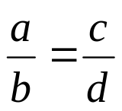
Proportion
An equation stating that two ratios are equal
  Example:
Cross products: means and extremes
  Example:
a and d = extremes
b and c = means
ad = bc

Slide 3
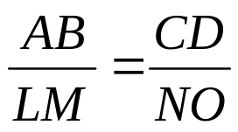
Similar Polygons
Similar polygons have:
    Congruent corresponding angles
    Proportional corresponding sides
Scale factor: the ratio of corresponding sides
A
Polygon ABCDE ~ Polygon LMNOP
L
B
E
M
P
Ex:
C
D
N
O

Slide 4

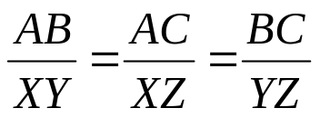

Similar Triangles
Similar triangles have congruent corresponding angles and proportional corresponding sides
Z
Y
A
C
X
B
angle A angle X
angle B angle Y
angle C angle Z
ABC ~ XYZ

Slide 5
Similar Triangles
Triangles are similar if you show:
  Any 2 pairs of corresponding sides are proportional and the included angles are congruent (SAS Similarity)
B
R
12
6
18
C
T
A
4
S

Slide 6
Similar Triangles
Triangles are similar if you show:
  All 3 pairs of corresponding sides are proportional (SSS Similarity)
B
R
6
5
10
C
7
T
A
14
3
S

Slide 7
Similar Triangles
Triangles are similar if you show:
  Any 2 pairs of corresponding angles are congruent (AA Similarity)
B
R
C
T
A
S

Slide 8
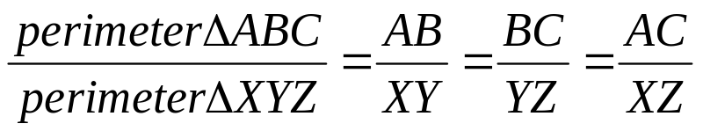
Parts of Similar Triangles
If two triangles are similar, then the perimeters are proportional to the measures of corresponding sides
X
A
B
C
Y
Z

Slide 9
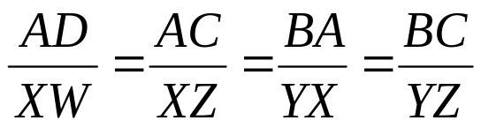
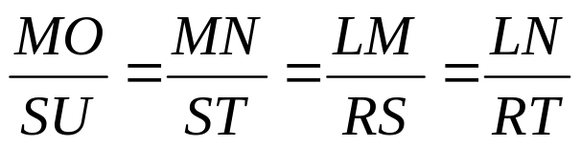
Parts of Similar Triangles
If two triangles are similar:
the measures of the corresponding altitudes are proportional to the corresponding sides
the measures of the corresponding angle bisectors are proportional to the corresponding sides
A
X
S
M
B
C
D
Y
Z
W
R
L
N
U
T
O

Slide 10
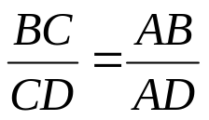
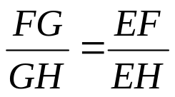
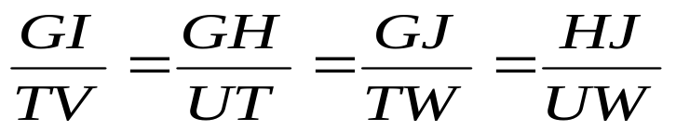
Parts of Similar Triangles
If 2 triangles are similar, then the measures of the corresponding medians are proportional to the corresponding sides.
An angle bisector in a triangle cuts the opposite side into segments that are proportional to the other sides
E
A
G
T
B
D
J
C
H
I
F
H
G
U
V
W

Slide 11
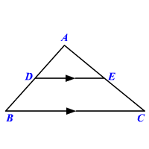
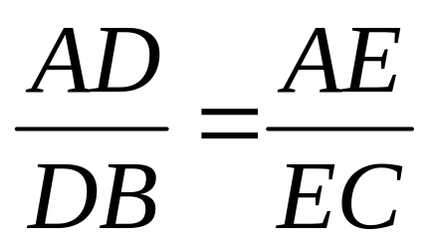
Theorem
Triangle Proportionality Theorem
If a line is parallel to one side of a triangle and intersects the other two sides, then it divides the two sides proportionally.

Slide 12
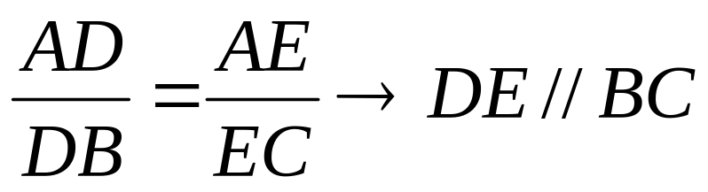
Converse of the Triangle Proportionally Theorem
If a line divides two sides of a triangle proportionally, then the line is parallel to the remaining side.

Slide 13

Parallel Lines and Proportional Parts
Triangle Midsegment Theorem
  A midsegment of a triangle is parallel to one side of a triangle, and its length is half of the side that it is parallel to
A
E
B
*If E and B are the midpoints of AD and AC respectively, then EB = DC
D
C

Slide 14
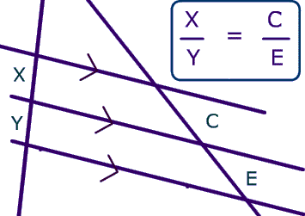
Theorem
If three parallel lines are intersected by two lines, then the lines are divided proportionally.

Slide 15
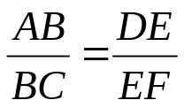
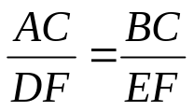
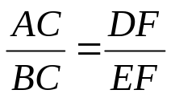
Parallel Lines and Proportional Parts
If 3 or more lines are parallel and intersect two transversals, then they cut the transversals into proportional parts
C
B
A
D
E
F

Slide 16


Parallel Lines and Proportional Parts
If 3 or more parallel lines cut off congruent segments on one transversal, then they cut off congruent segments on every transversal
C
B
A
D
If , then
E
F

Slide 17
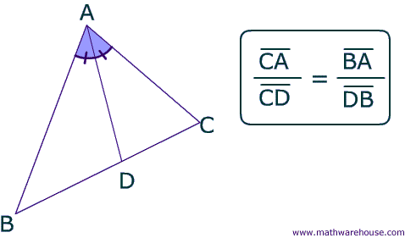
Theorem
If a ray bisects one angle of a triangle, then it divides the sides proportional with the sides they are touching.

Slide 18
Lets look at some worked examples

Slide 19
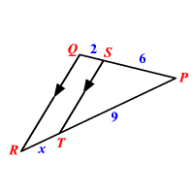
Solve for x

Slide 20
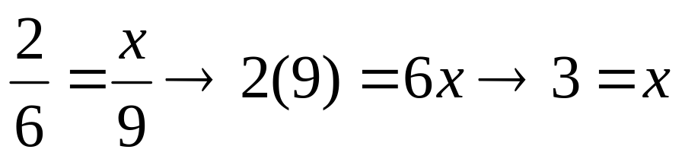
Solve for x

Slide 21
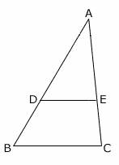




Show that DE // BC

Slide 22
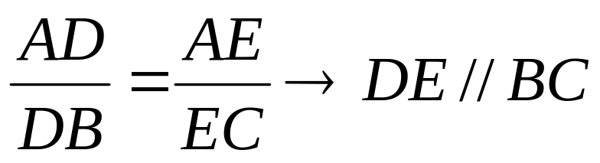
Show that DE // BC

Slide 23




Solve for x

Slide 24
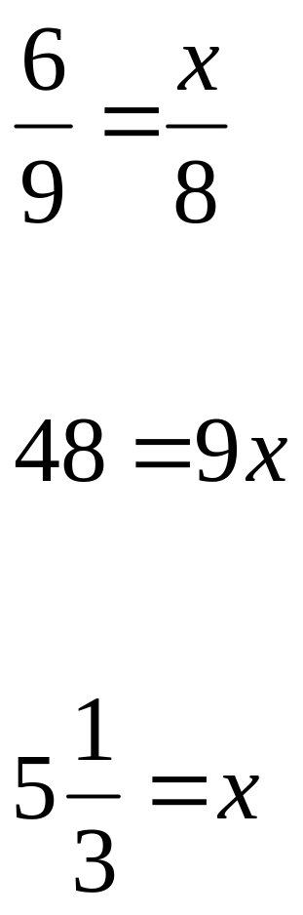
Solve for x

Slide 25

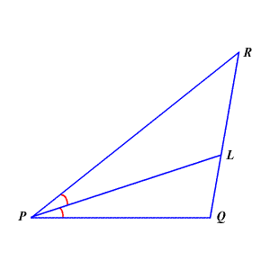



Solve for x

Slide 26
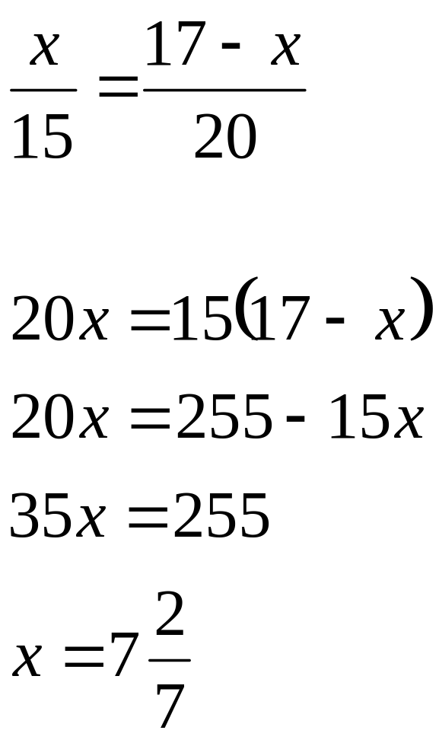
Solve for x

Slide 27
YOUR TURN

Slide 28
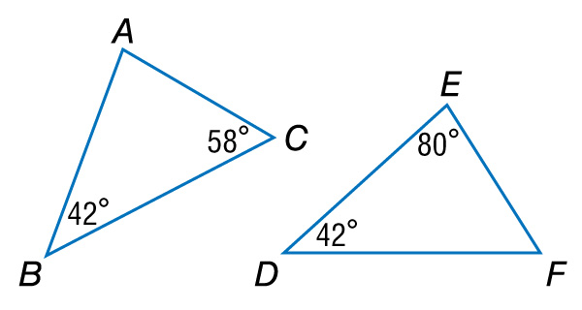
A. Determine whether the triangles are similar. If so, write a similarity statement. Explain your reasoning.

Slide 29
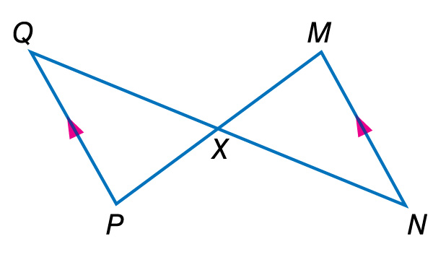
B. Determine whether the triangles are similar. If so, write a similarity statement. Explain your reasoning.

Slide 30
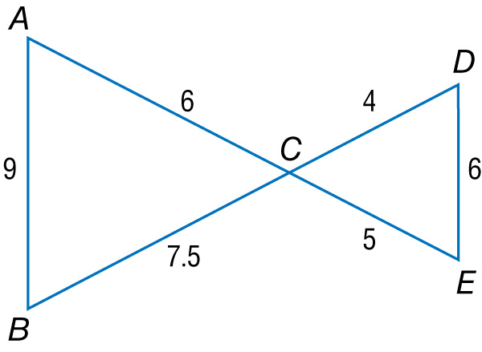
A. Determine whether the triangles are similar. If so, write a similarity statement. Explain your reasoning.

Slide 31
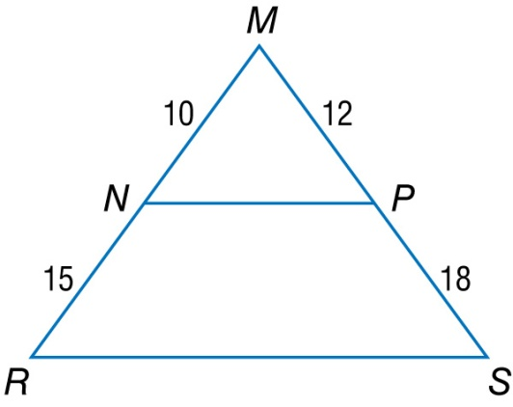
B. Determine whether the triangles are similar. If so, write a similarity statement. Explain your reasoning.

Slide 32
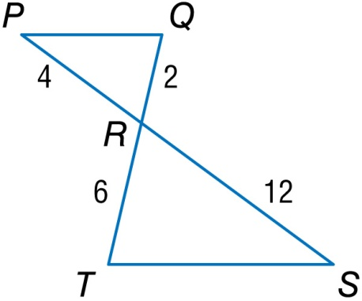
A. Determine whether the triangles are similar. If so, choose the correct similarity statement to match the given data.

Slide 33
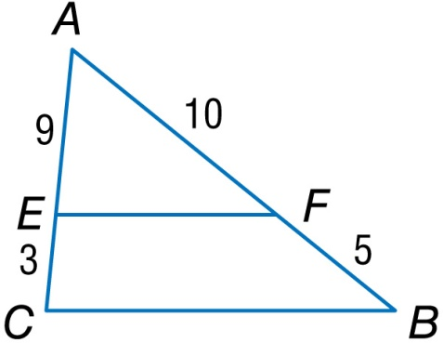
B. Determine whether the triangles are similar. If so, choose the correct similarity statement to match the given data.

Slide 34

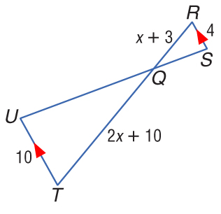
ALGEBRA Given , RS = 4, RQ = x + 3,
QT = 2x + 10, UT = 10, find RQ and QT.

Slide 35
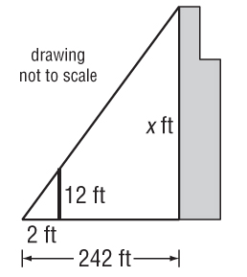
SKYSCRAPERS Josh wanted to measure the height of the Sears Tower in Chicago. He used a
12-foot light pole and measured its shadow at 1 p.m. The length of the shadow was 2 feet. Then he measured the length of the
Sears Tower’s shadow and it
was 242 feet at the same time.
What is the height of the
Sears Tower?

Slide 36
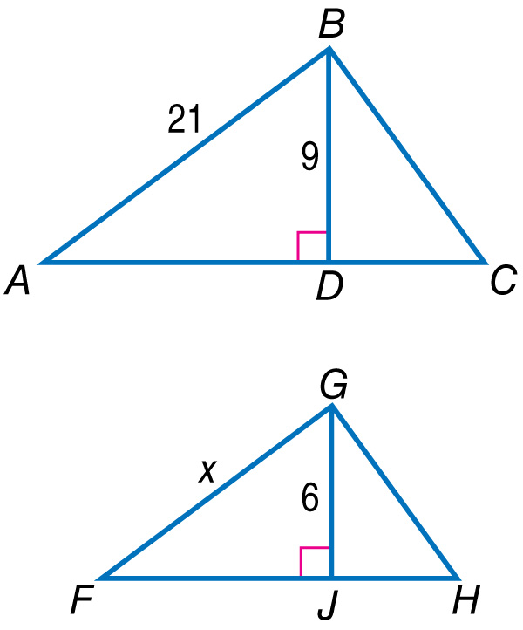
In the figure, ΔABC ~ ΔFGH. Find the value of x.

Slide 37
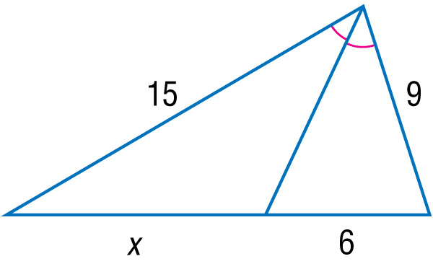
Find x.

Slide 38
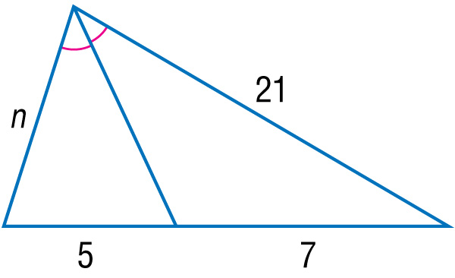
Find n.

